Slide 1
Simulated Smart Car with Reinforcement Learning
Maroof H. Khan
Notes:
Hi Everyone
I am Maroof
Today I will be talking about my project → The simulated smart car with reinforcement learning

Slide 2
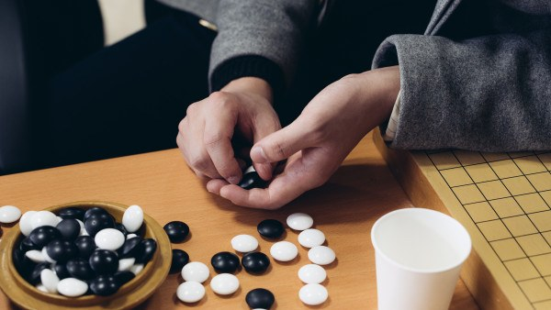
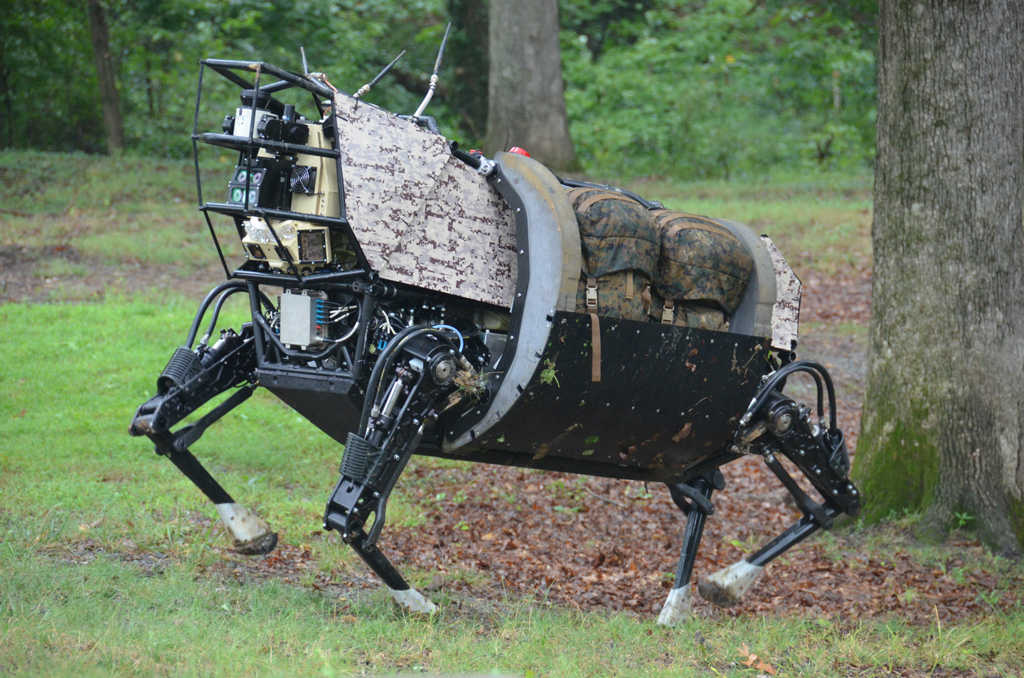
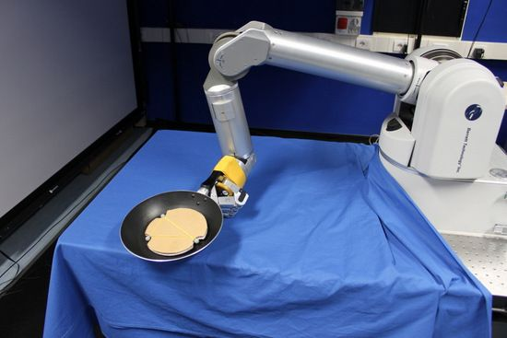


Motivation for using Reinforcement Learning
2016
2014
Italian Inst. Tech 2010
Start from first principles
Update algorithm to increase learning efficiency
Notes:
Reinforcement Learning has gotten a lot of publicity recently with alpha go and advances in robotics
Application of RL is in fields where conventional learning is just too complex
The system needs to learn by interacting with the environment
RL systems have been known to figure out complex game of GO or even robot movement
My motivation is to start from first principles and update algorithm to make it more efficient
=================================================
The motivation for this project comes from projects such as
Recent alpha-go, various robotics projects where reinforcement learning was used.
All of these examples have one thing in common
The systems above learn through interaction with their environment and do not have rules specifying the correct action

Slide 3
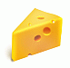

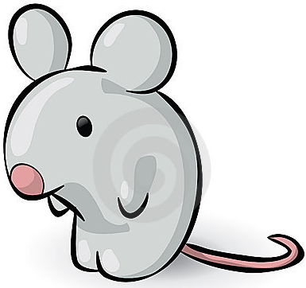
What is Reinforcement Learning
100
0
20
0
0
0
0
0
-100
0
Agent
0
Movements of the mouse are stochastic
Aim is to find a policy [strategy] that maximizes reward of agent [mouse]
Notes:
Take for example a mouse trying to find food and not become it
It does not know anything about its environment
Hence it needs to making steps to adjoining grid states
And will only stop either when it gets the cheese to dies
And in so doing create a value matrix that will show it the optimal path to follow

Slide 4
Two modes of Learning
Exploration
Exploitation
100
20
100
20
15
10
-100
Agent
-100
Agent
5
Even if the optimal strategy is found we will have exploration available.
After learning is done we have explored all avenues we have optimal strategy [get to cheese in shortest number of steps, avoiding the cat]
Notes:
The two modes of RL is exploration and exploitation
Take the example on the right,
The mouse found a path to the lower reward, if it chooses to exploit this path only it will never find the big cheese
We should allow the mouse of make random walks to figure out the terrain and permeate the initial reward to all states

Slide 5

Process
Reward
System
Simulator
Learner
Strategy
transitions
Used in
Created game with
Applied to
First Implementation
Second Implementation
Grid Implementation from scratch
Input layers
Flatten out 3D grid
Hidden layers
Actions
Decision
Up
Grid States
Down
Left
left
right
Obstacles
down
Right
up
My Car
Police car
Notes:
- We start with a reward system
this gets passed into a simulator, which is my pygame
Through transitions of the car we are learning the environment
Finally we find the optimal stategy
This strategy is applied back the pygame
First implementation is defining a matrix implementation of grid-action states
Second implementation is taking a 3D representation of obstacle, our and police car,
and training it on two layers of a neural net
- After training we get a decision as output

Slide 6
DEMO

Slide 7
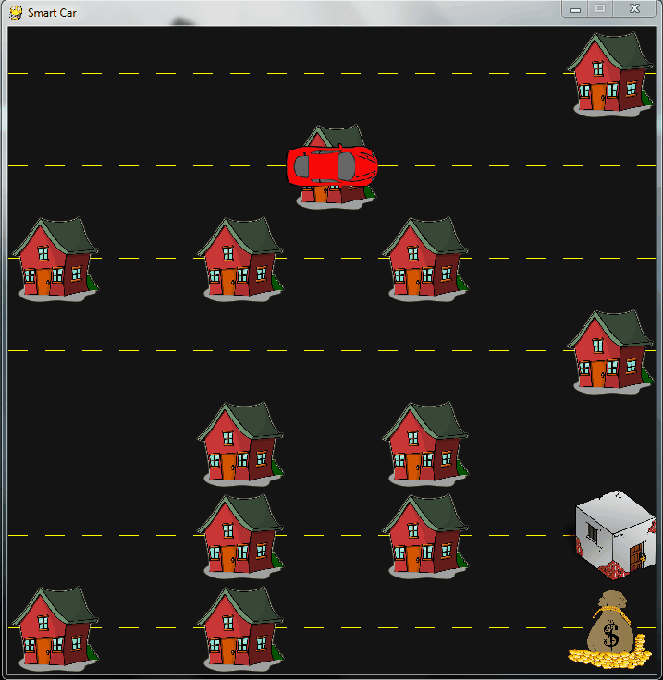
Training
Convention Training time
15 mins
Updated Training time
8 mins
Notes:
The supposedly smart car needs to go to the bank and avoid jail
It is not supposed to hit the houses
What you can see that during training it is hitting
You can see that the car is literally hitting all the obstacles (negative weights)
and it has no idea of where to go
This initial random motion will get smoother when it reaches either of the end states (cash money or jailHouse)
This training occurs thousands of time

Slide 8
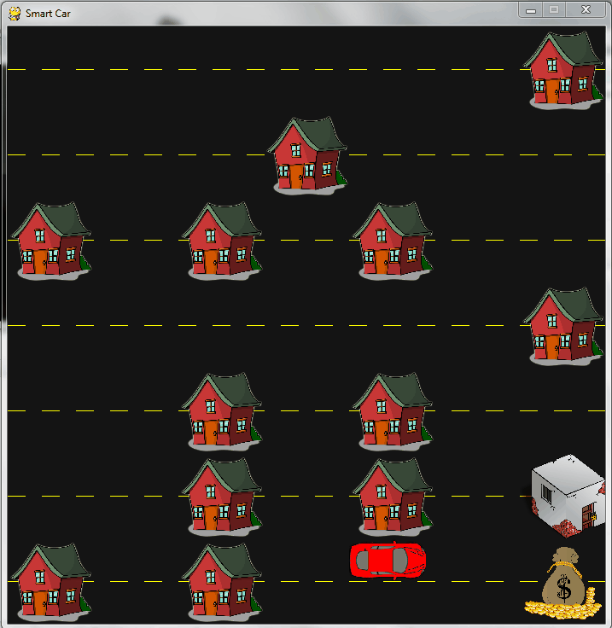
Static case after training
Notes:
In this case the car has figured out where to go
And no matter what the starting point it, it finds the optimal route to get there

Slide 9
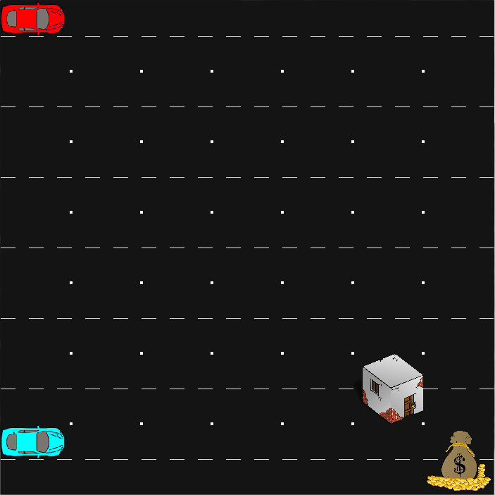
Dynamic Environment Update
Reward
System
Simulator
Learner
Strategy
transitions
Change
Update
Opponent
X
100,000
Notes:
- To make things more interesting lets introduce a dynamic entity to interact with our car
- Generic way to do this is for each transition of the cyan car we would have trained a model
- This seemed like a huge time drain

Slide 10
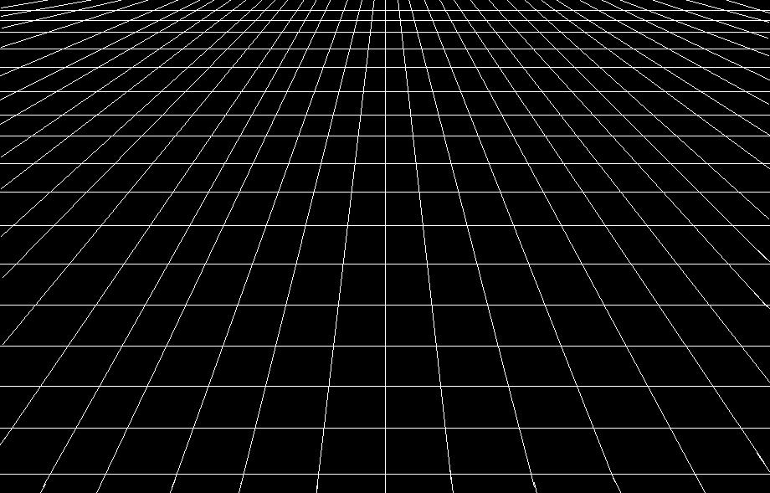
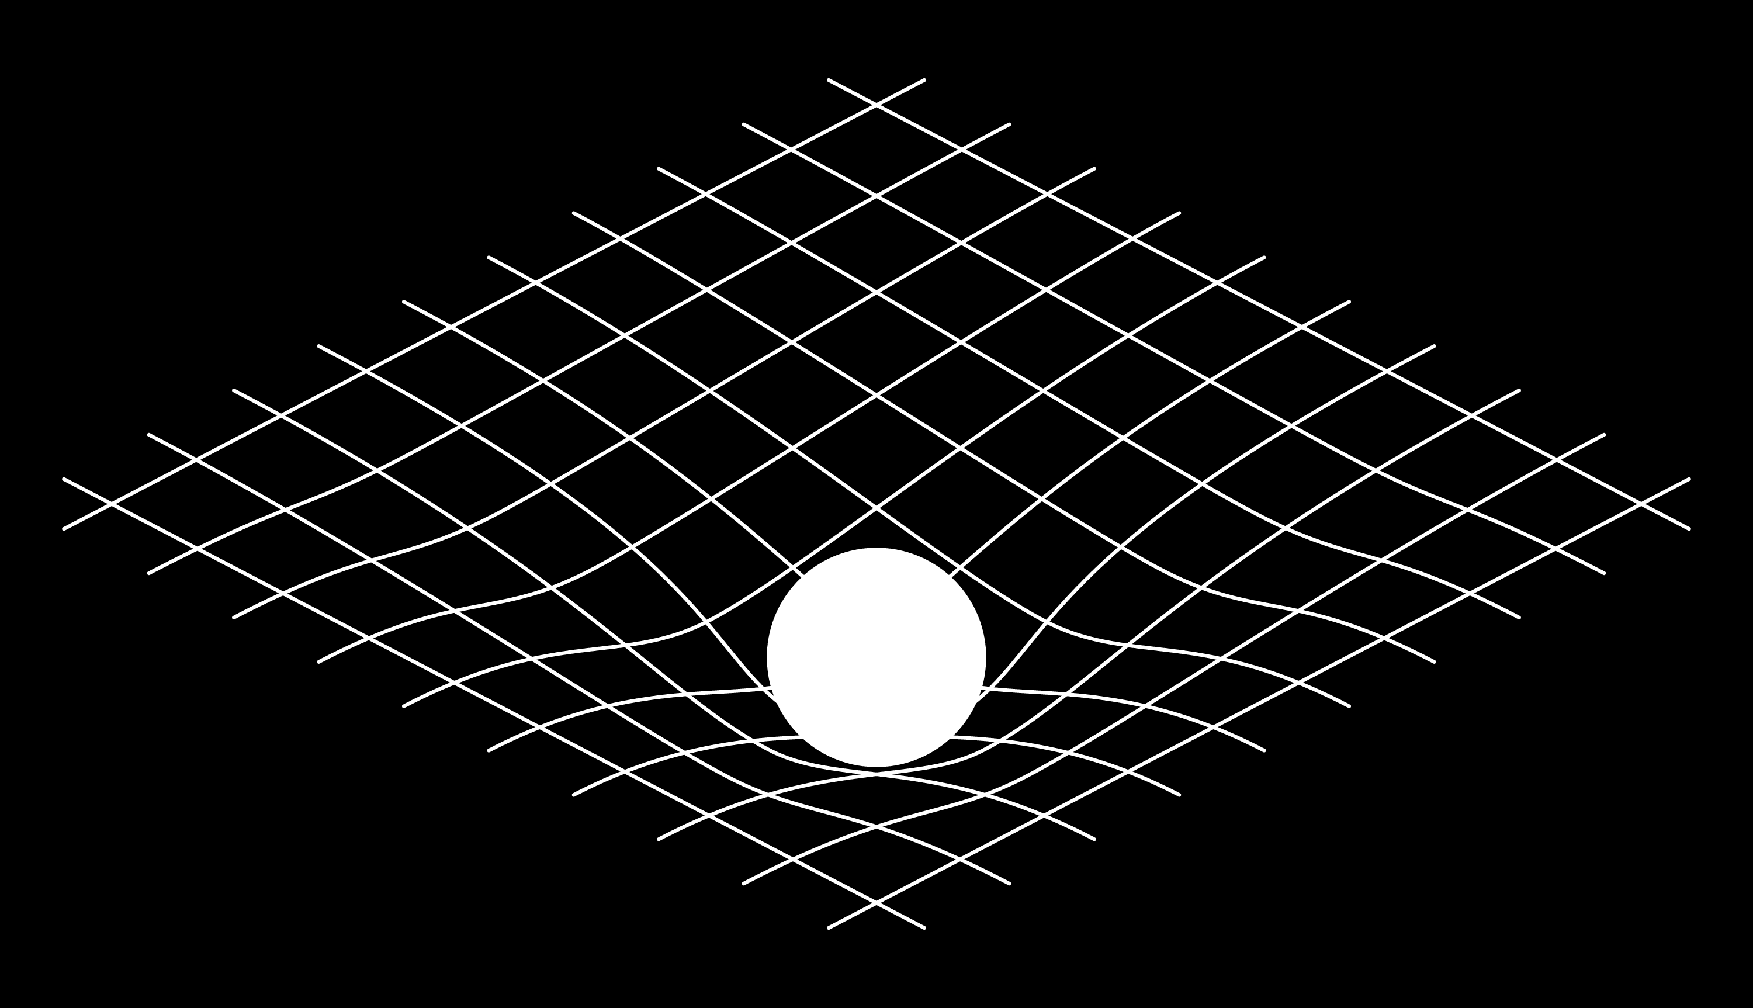
Dynamic Environment Update
Reward
System
Simulator
Learner
Strategy
transitions
Update
Opponent
Change
Without Obstacles
With Obstacles
Notes:
My solution is to forgo training altogather
For visualization purposes think the police as distorting the reward matrix
This will affect our car since it will always avoid these depression

Slide 11
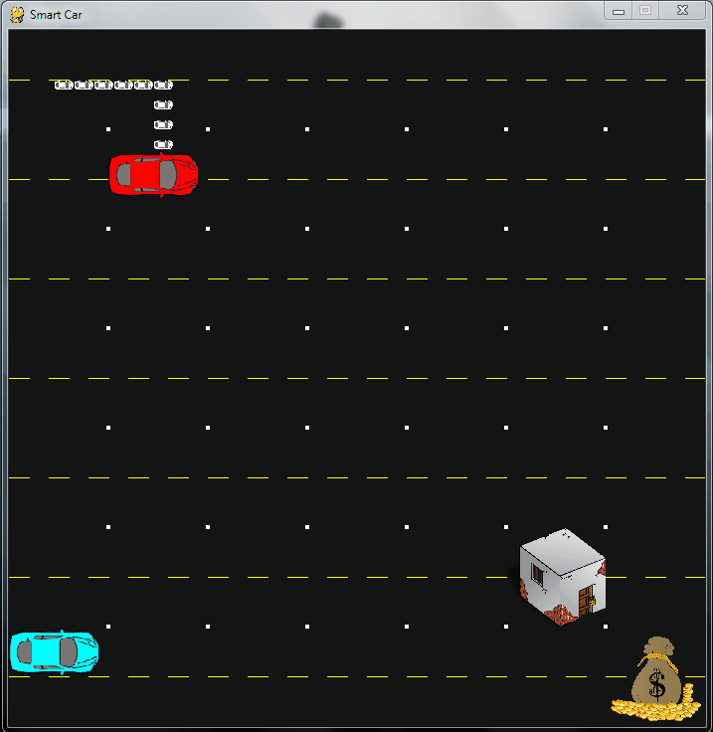
Dynamic Environment Update
Notes:
We have a trail showing the path of initial car
Police block him and find that the course of action has changed
If tries the optimal path multiple time, if this is not possible it as mentioned previously randomly moves to another state thereby aiding in completing the task

Slide 12
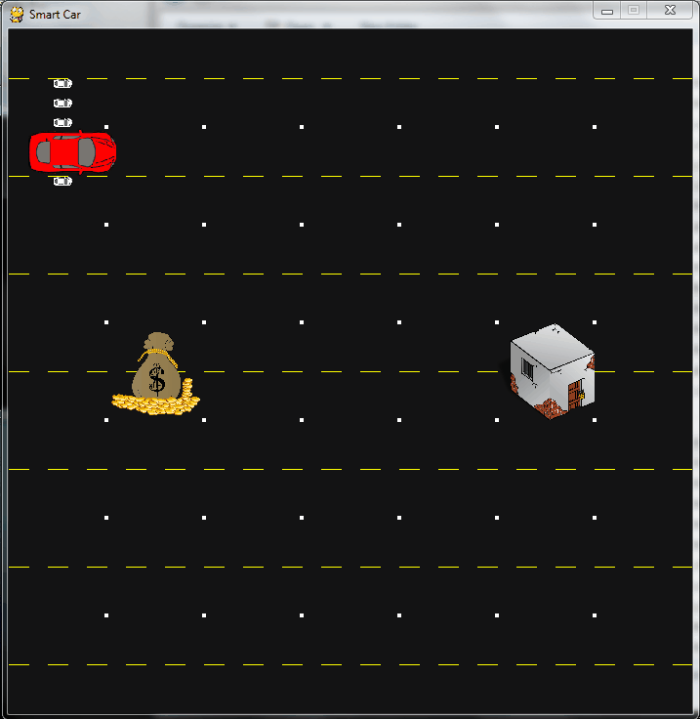
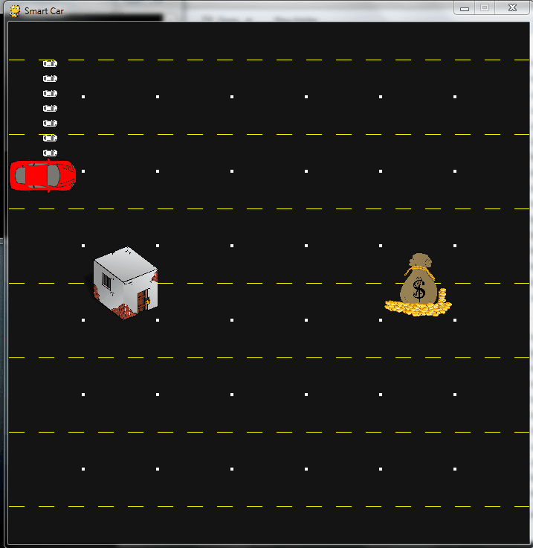
Change Reward State without any training
Actions
Grid States
Apply transformation
No Training
Required!
Notes:
To consider another scenario that would not be possible to train.
The money and jail reward/punishment are integral to making the value space and one
Cannot simply the previous strategy
I thought of a way of doing this without ANY ADDITIONAL TRAINING
Just take the matrix representation of value function and apply linear transformations
Results are pretty conclusive

Slide 13
Applications
Apply updated algorithm to autonomous robots
Use Inverse RL to train robot faster
References:
R. Sutton, A. Barto, Reinforcement Learning: An Introduction
S. Levine, Z. Popovic, V. Koltun, “Future Construction for Inverse Reinforcement Learning”
L. Lin, “Programming Robots Using Reinforcement Learning and Teaching”, AAAI Proceedings, vol 92, 781-786 (1991)
Notes:
I have successfully lowered training times
Found strategies to bypass training for dynamic cases
Further work will look to extend these efficiencies

Slide 14










Maroof H. Khan
Background
Contact
PhD, Applied Physics
maroof.hk@gmail.com
Technical Analyst
Optical scanner systems
/in/maroofhk
github.com/maroofhk
maroofhk.github.io
Technology used:

Slide 15
EXTRA

Slide 16
Thanks:
Metis Team:
Brian Lucena
Andrew Blevins
Ramesh Sampath
Andrew Savage
Heather Lockhart
Metis SF Cohort 3 Gang!

Slide 17
Further work
Look into shortening training time even further
Distort value function for any configuration of states
Look into applying this to Inverse Reinforcement Learning
Make the game look better!
Notes:
I have successfully lowered training times
Found strategies to bypass training for dynamic cases
Further work will look to extend these efficiencies

Slide 18
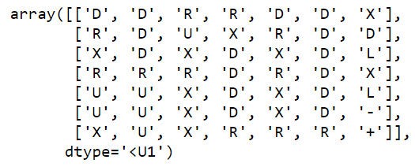
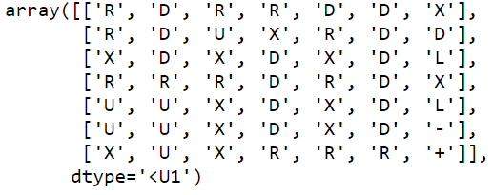
How about dynamic situations
Strategy 1: Train for all contingencies
Strategy 2: Dynamically update q-matrix with negative rewards
Example:

Slide 19
Further Improvements
Apply pixel level data

Slide 20
Two modes
Exploitation
Exploration
100
100
-100
50
-100
50
0
Agent
0
20
Agent
20
Even if the optimal strategy is found we will have exploration available.
After learning is done we have explored all avenues we have optimal strategy [get to cheese in shortest number of steps, avoiding the cat]

Slide 21
What is Reinforcement Learning
Reinforcement learning is learning what to do – how to map situations to actions – so as to maximize a numerical reward signal.
The learner is not told which actions to take, as in more forms of machine learning, but instead must discover which actions yield the most reward by trying them.
Reinforcement Learning: An Introduction
Richard S. Sutton and Andrew G. Barto

Slide 22
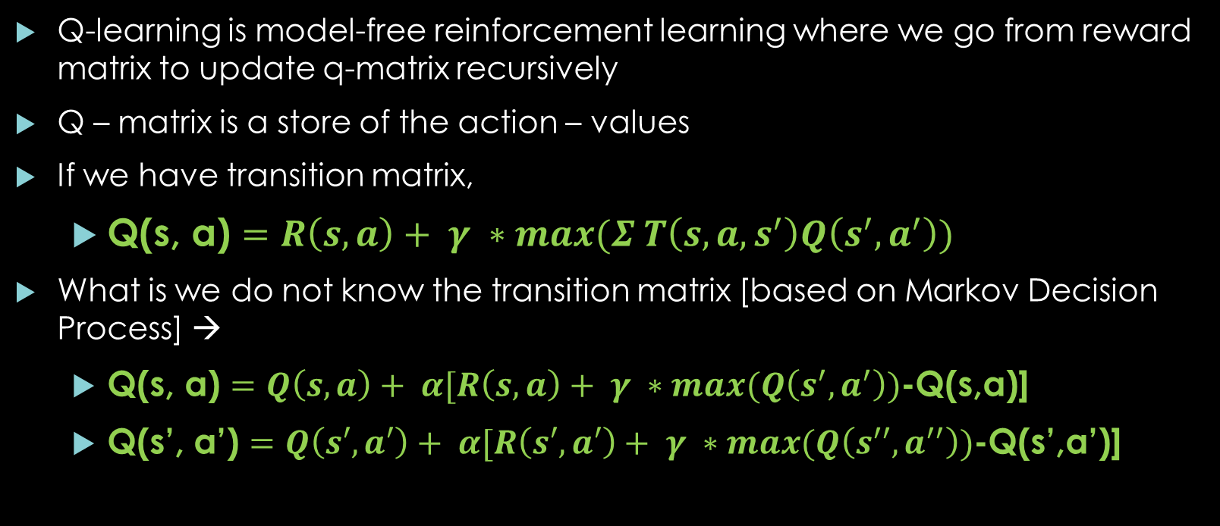
Recursive Q- update
Q-learning is model-free reinforcement learning where we go from reward matrix to update q-matrix recursively
Q – matrix is a store of the action – values
If we have transition matrix,
Q(s, a) $=R\left(s,a\right)+ γ ∗max(Σ T\left(s,a,s^{′}\right)Q\left(s^{′},a^{′}\right))$
What is we do not know the transition matrix [based on Markov Decision Process] →
Q(s, a) $=Q\left(s, a\right)+ α[R\left(s,a\right)+ γ ∗max(Q\left(s^{′},a^{′}\right))$-Q(s,a)]
Q(s’, a’) $=Q\left(s′, a′\right)+ α[R\left(s′,a′\right)+ γ ∗max(Q\left(s^{′′},a^{′′}\right))$-Q(s’,a’)]

Slide 23
Process
Reward
System
Simulator
Learner
Strategy
transitions
Used in
Applied to
Generated
Game

